Slide 1






AMAZON WEB SERIVICES TRAINING
In Collaborating With ICT Acadmey
PRESENTATION
ON
CAPSTONE PROJECT

Slide 2

AUTOMATION: Auto
Scaling and Load Balancing of the traffic into the servers
By Team - Aman Kumar Malaiya
and
Virat Kumar Singh
Under The Guidence of:
Mr.Saransh Jain

Slide 3


Automation of Scaling of the servers as per the traffic.
Load balancing of the traffic among all the servers.
Cost optimization via server management in the fleet.
A layer of security for HTTPS request via load balancer.
Analytics through monitoring for the future innovation.
Solutions delivered by the project

Slide 4
Part 01
EC2 Instance
Part 02
VPC
Part 03
AMI for AutoScaling
CONTENT
Part 04
Load Balancer
Part 05
Auto Scaling Group
Part 06
Cloud Watch
Part 07
Outcome

Slide 5
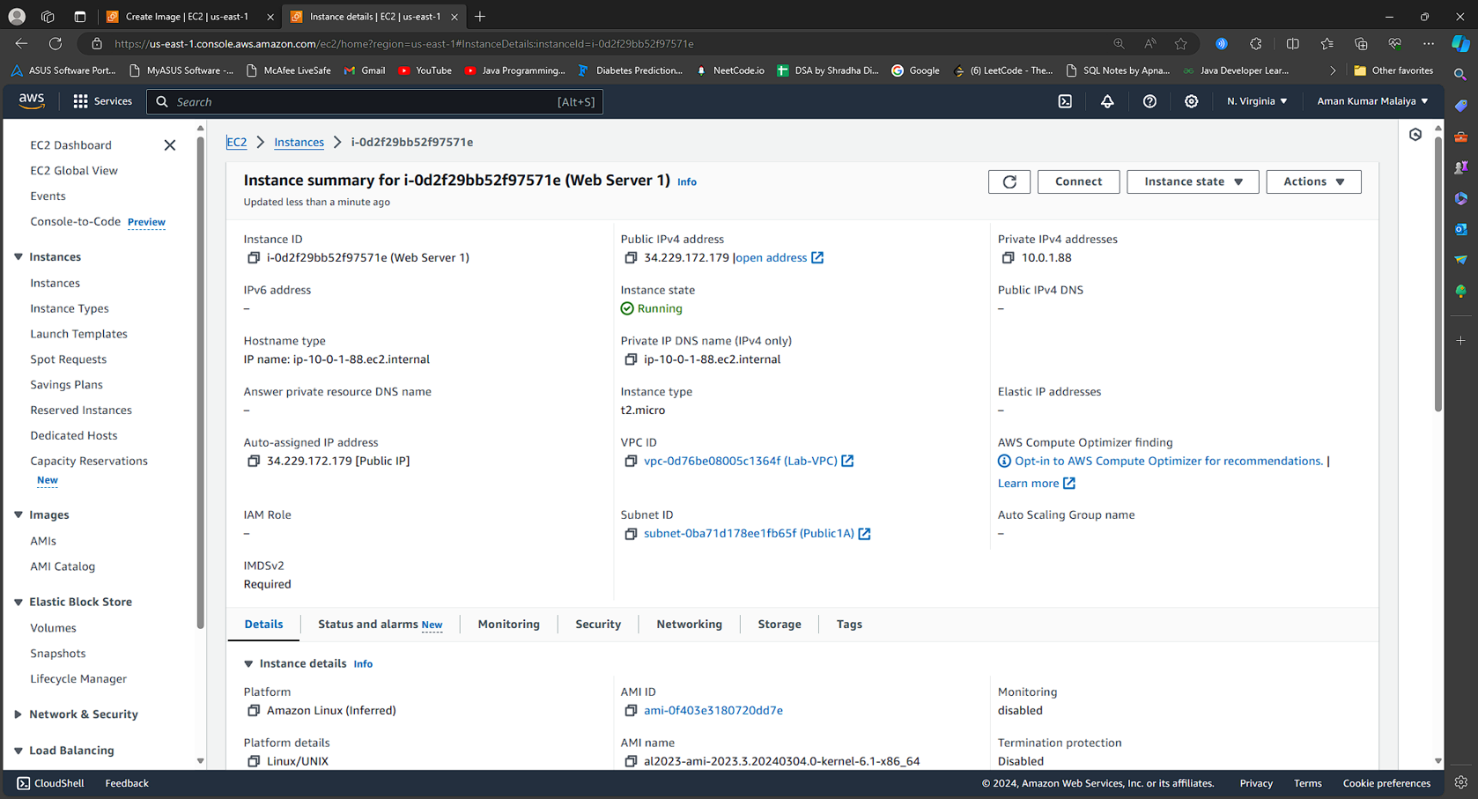
EC2 INSTANCES
Amazon Elastic Compute Cloud (Amazon EC2)
is a web service that provides secure,
resizable compute capacity in the cloud.
It is designed to make web-scale cloud
computing easier for developers.
We have to generate the instances to
provide the basic server to host our
website.

Slide 6
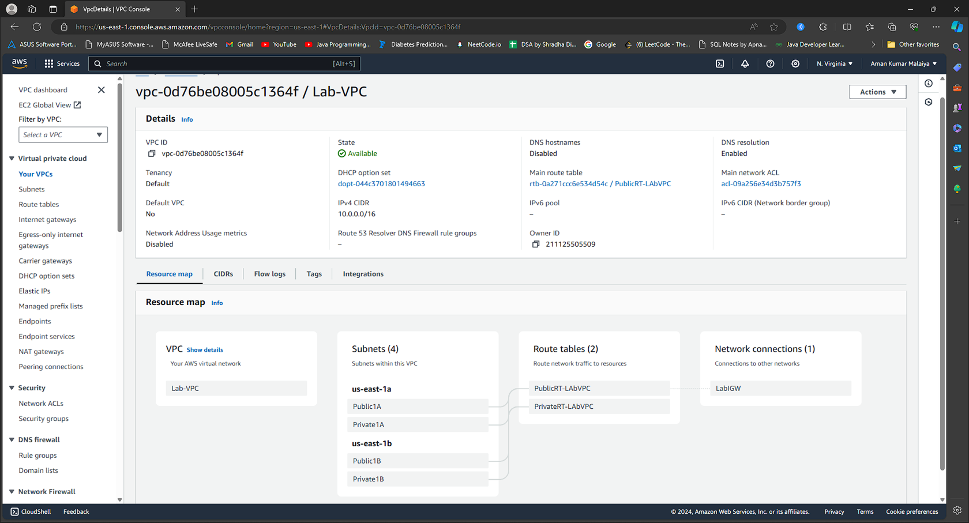
VPC(VIRTUAL PRIVATE CLOUD)
A virtual private cloud (VPC) is a secure, isolated private cloud hosted within a public cloud.
It is designed to make web-scale cloud
computing easier for developers.
VPC customers can run code, store data,
host websites, and do anything else they
could do in an ordinary private cloud,
but the private cloud is hosted remotely
by a public cloud provider.

Slide 7
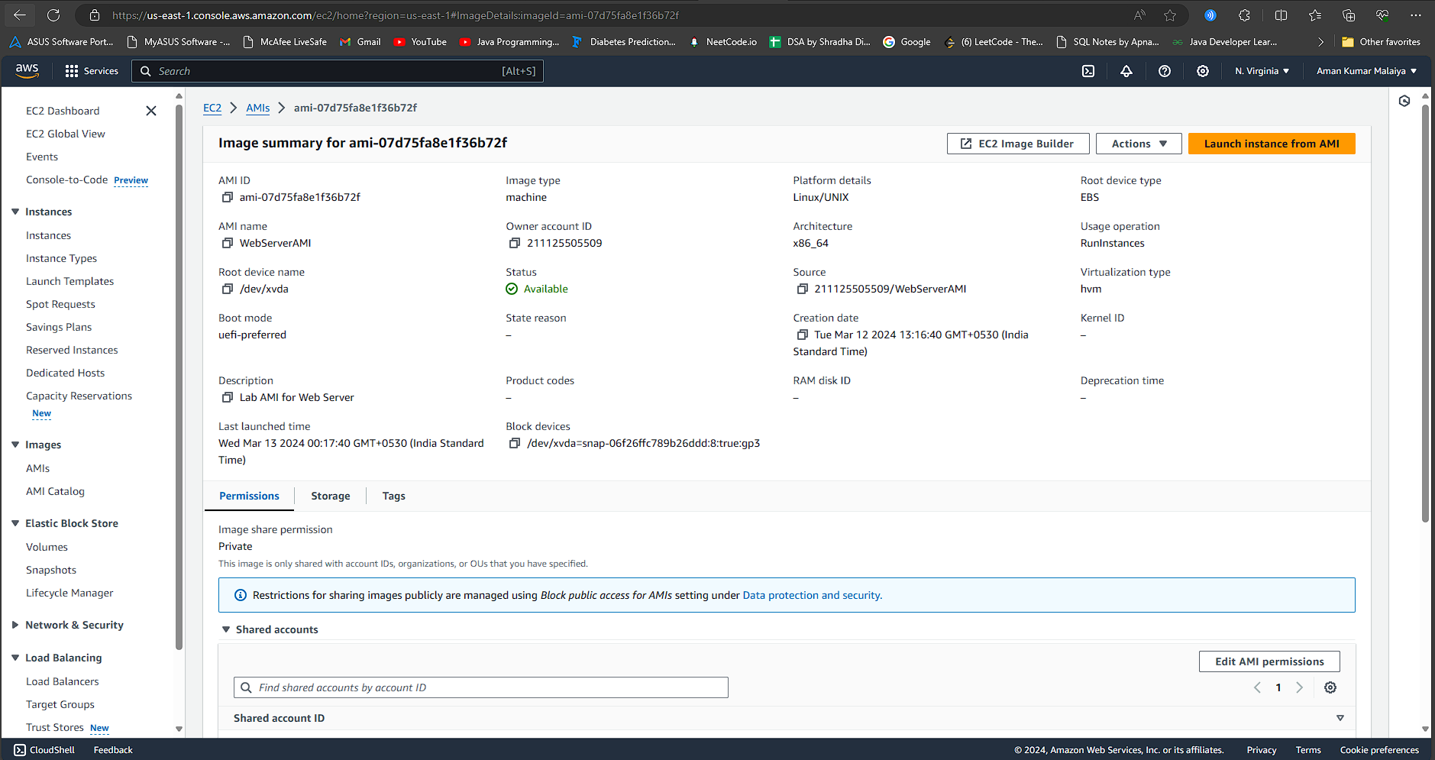
AMI(AMAZON MACHINE IMAGE)
An Amazon Machine Image (AMI) in AWS is a
template that contains the software
configuration (such as an operating system,
application server, and applications)required
to launch an instance(a virtual server)
in the Amazon Elastic Compute Cloud (EC2)..
AMI allow you to pre-install and required
packages on an EC2 intances,improve boot
time, security controls.
Different types of instances can be launched
from a single AMI to support the hardware of
the host computer used for the instance.

Slide 8
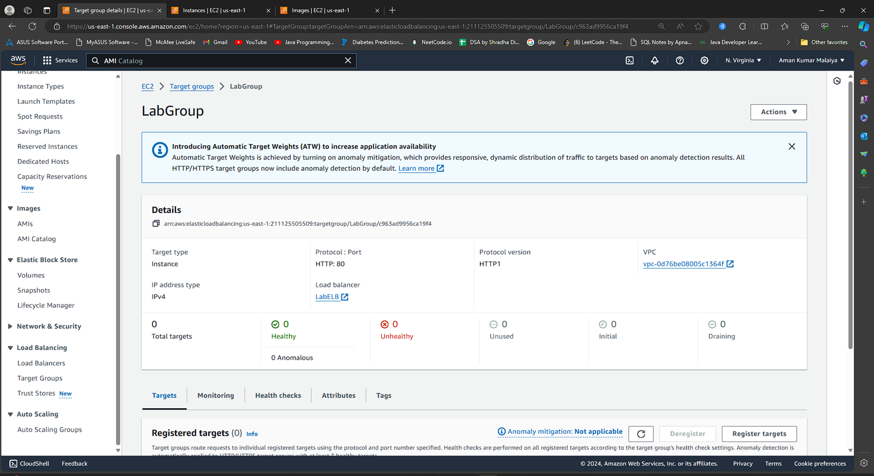
LOAD BALANCER- TARGET GROUPS
Target Group (Load Balancer)
A target group in AWS Load Balancer acts as
a destination for incoming traffic,directing requests to registered
instances based on defined routing rules..
The Application Load Balancer can send
traffic to multiple Target Groups based
upon the URL of the incoming request,
such as having requests from mobile
apps going to a different set of servers.
Your web application will use only one
Target Group.
Targets are the individual instances that
will respond to requests from the Load
Balancer.

Slide 9
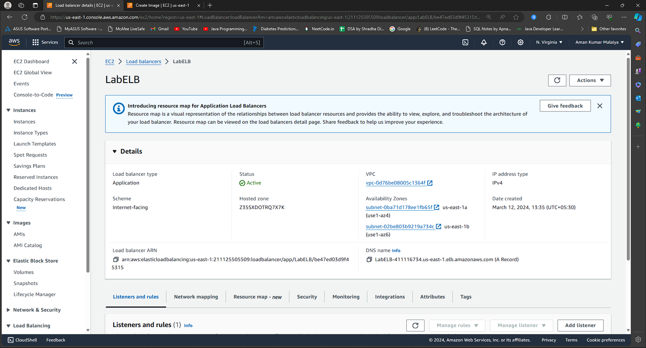
LOAD BALANCER
A load balancer serves as the single point
of contact for clients.
The load balancer distributes incoming
application traffic across multiple targets,
such as EC2 instances,in multiple
Availability Zones.
This increases the availability of your
application.You add one or more listeners
to your load balancer.

Slide 10
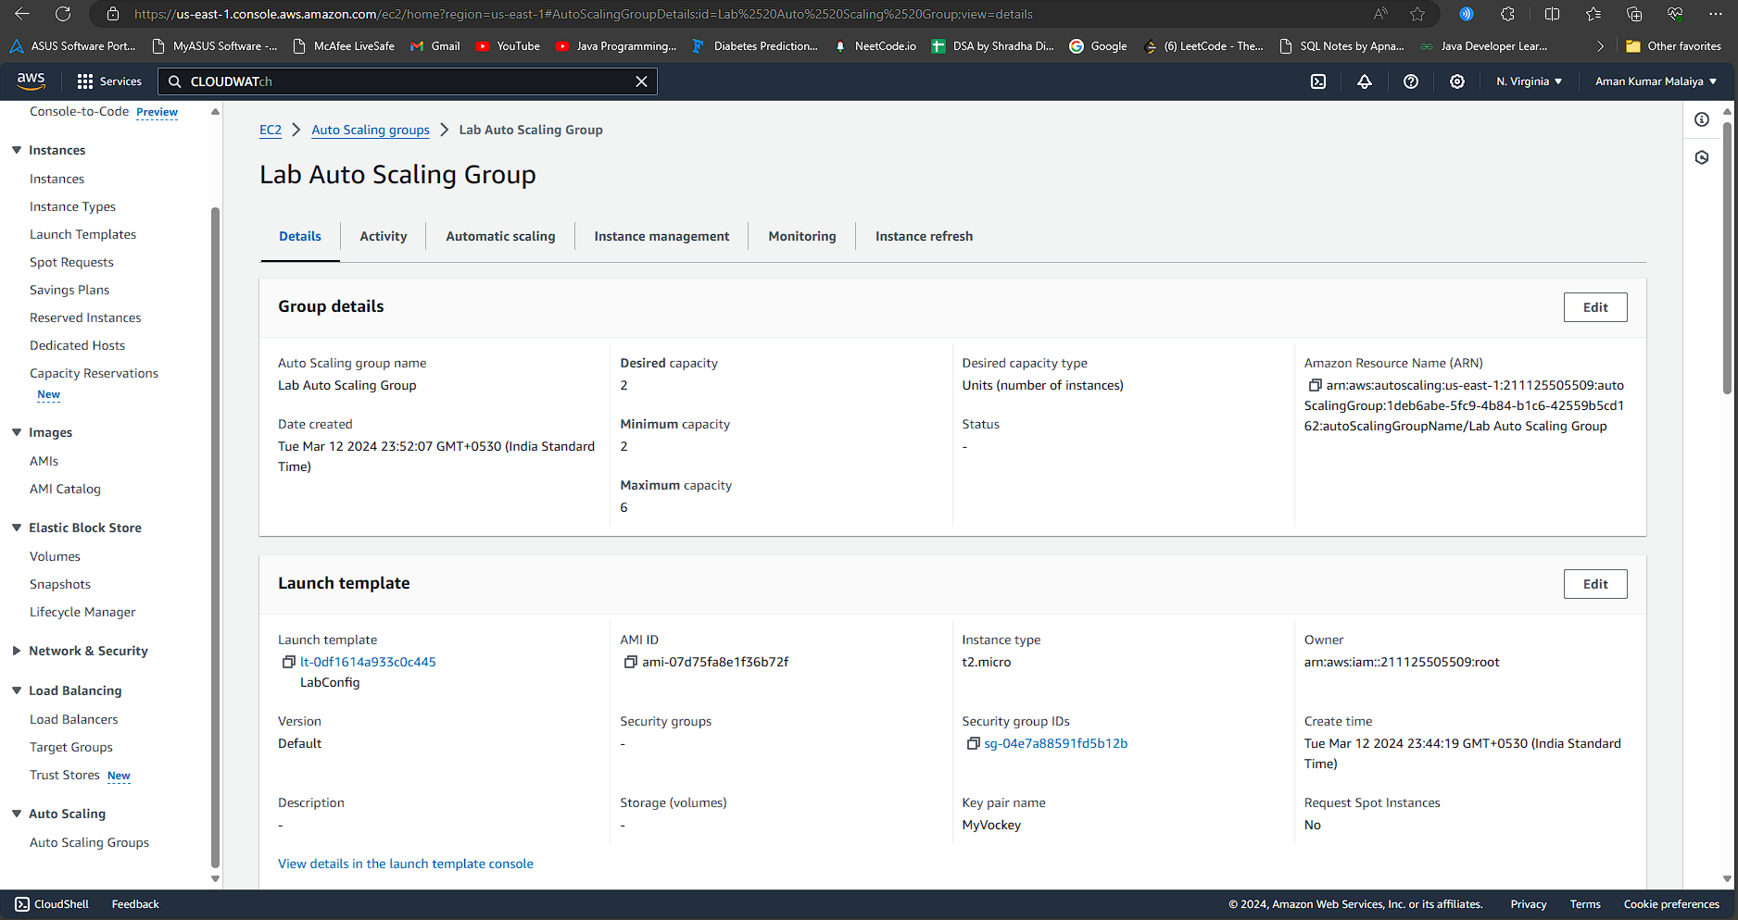
Auto Scaling Group
An Auto Scaling Group in AWS
automatically adjusts the number of
EC2 instances based on defined
policies or metrics.
By using Auto Scaling, the company
ensures that the web application can
handle varying levels of demand
efficiently, maintaining optimal
performance for users while optimizing
costs by only using resources when
needed.

Slide 11
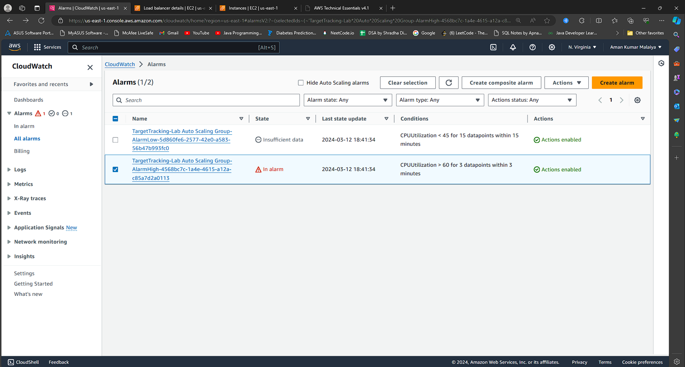
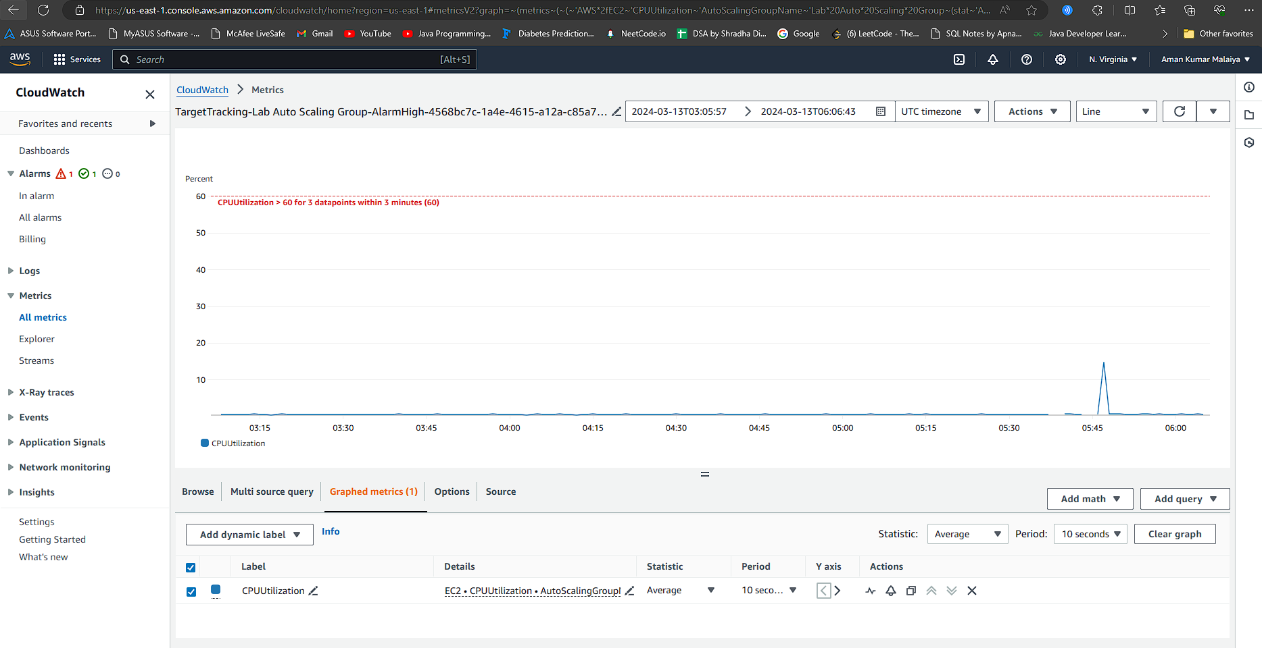
CLOUD WATCH
The AlarmLow alarm should change to OK
and the AlarmHigh alarm status should
change to In alarm..
You should see the AlarmHigh chart
indicating an increasing CPU percentage.
Amazon CloudWatch is a monitoring and
observability service provided by AWS.
It collects and tracks metrics, logs,
and events from various AWS services,
allowing users to gain insights into
their applications, infrastructure,and
overall system health.

Slide 12
Together, Auto Scaling and load balancing ensure high availability, fault tolerance, and cost-effectiveness for your applications running in the cloud.
Conclusion

Slide 13
THANK YOU
Notes:
亲,本文档特殊字体为“Impact”.“Arial”和“方正正大黑简体”,字体下载推荐网址http://www.qiuziti.com/,下载解压缩后将字体复制至C盘WINDOWS文件夹里的FONTS文件夹下即可.欲寻更多优质作品,欢迎收藏不贰店铺:http://chn.docer.com/works?userid=14520189

